Slide 1
Electric Current

Slide 2
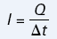
Electric Current
When electric charges move from one place to another, we say they constitute an electric current
In metals, these moving charges are electrons, which have a negative charge. Consider a cylindrical wire (Figure 1) of known cross-sectional area, with a total
charge Q (in coulombs) flowing through the area A in a time t (in seconds).
Then the electric current I through the wire is

Slide 3
Electric Current
Electric current is measured in units called amperes (A)
1 A is the electric current when 1 C of charge moves past a point in a conductor in 1 s.
1 A = 1 C/s
The charge (Q) involved in the calculation of current is the magnitude of the net charge that passes through the cross-section. It is calculated by multiplying the elementary charge (e) by the number of elementary charges (N) that pass through the cross-section:
Q = Ne

Slide 4
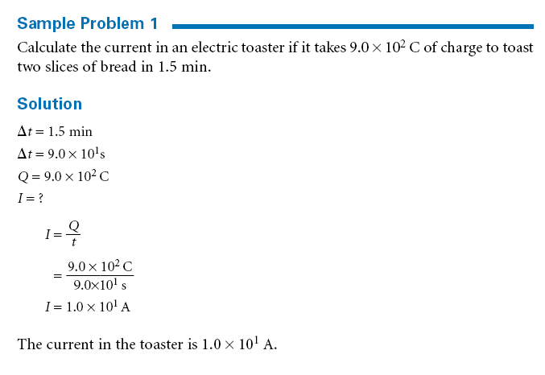

Slide 5
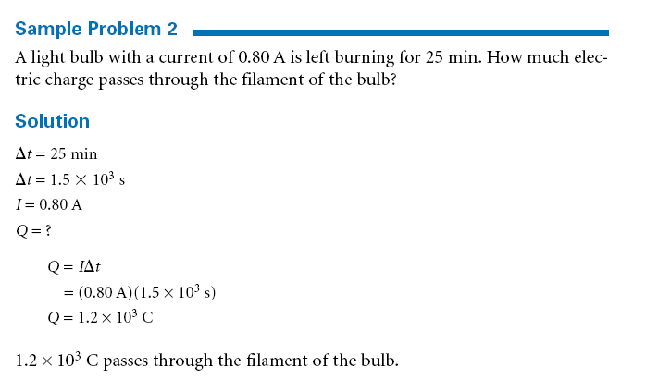

Slide 6
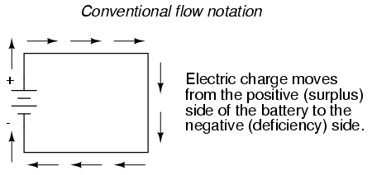
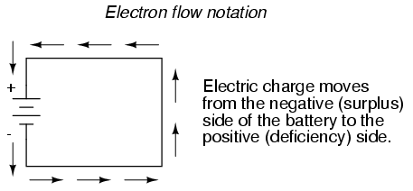
Current Flow

Slide 7
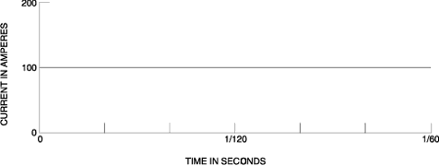
Difference between DC & AC power?

Slide 8
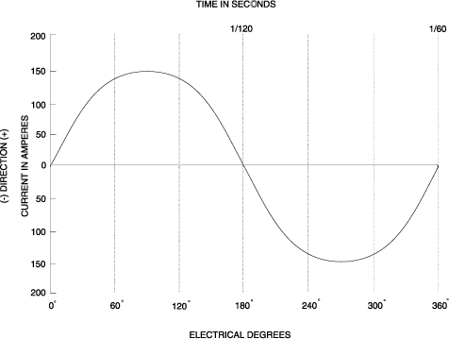

Slide 9
Problems:
Page 438 #’s 1-5
Page 441 #’s 1-9

